Slide 1

30 YEARS STOCK MARKET DATA
Presented By:
B.B.Poornachandran B.E.-
Solamalai College of Engineering – 3rd Year Civil Engineering

Slide 2
OUTLINE
Need to invest
What is a stock market?
Financial Intermediaries
Average stock market return over 30 years
Stock market analysis approach
Stock market Algorithm & Deployment
Conclusion
Future Scope
Reference

Slide 3
NEED TO INVEST
Why should one invest
1. To drive the point across, let us make few simple assumptions.
2. The employer is kind enough to give you a 10% salary hike every year
3. The cost of living is likely to go up by 8% year on year.
4.Your expenses are fixed and don’t foresee any other expense
Fixed Income Instruments:
Typical fixed income investment includes:
1. Fixed deposits offered by banks
2. Bonds issued by the Government of India
3. Bonds issued by Government related agencies such as HUDCO, NHAI etc
4.Bonds issued by corporate
As of June 2014, the typical return from a fixed income instrument varies between 8% and 11%.

Slide 4
WHAT IS STOCK MARKET
Investing in equities is an important investment that we make in order to generate inflation beating returns. This was the conclusion we drew from the previous chapter. Having said that, how do we go about investing in equities? Clearly before we dwell further into this topic, it is extremely important to understand the ecosystem in which equities operate.
Just like the way we go to the neighborhood kirana store or a super market to shop for our daily
needs, similarly we go to the stock market to shop (read as transact) for equity investments.
Stock market is where everyone who wants to transact in shares go to. Transact in simple terms
means buying and selling. For all practical purposes, you can’t buy/sell shares of a public com-
pany like Infosys without transacting through the stock markets

Slide 5
FINANCIAL INTERMEDIARIES
Overview:
From the time you access the market – let’s just say, to buy a stock till the time the stocks comes
and hits your DEMAT account, a bunch of corporate entities are actively involved in making this
work for you. These entities play their role quietly behind the scene, always complying with the
rules laid out by SEBI and ensure an effortless and smooth experience for your transactions in the
stock market. These entities are generally referred to as the Financial Intermediaries.
The Stock Broker
The stock broker is probably one of the most important financial intermediaries that you
need to know. A stock broker is a corporate entity, registered as a trading member with the stock
exchange and holds a stock broking license. They operate under the guidelines prescribed by
SEBI

Slide 6
THE AVERAGE STOCK MARKET RETURN OVER 30 YEARS
Stock Market Average Yearly Return For The Last 30 Years The Average Yearly Return Of The S&P 500 Is 10.22% Over The Last 30 Years, As Of The End Of February 2024. This Assumes Dividends Are Reinvested. Adjusted For Inflation, The 30-year Average Stock Market Return (Including Dividends) Is 7.5%.

Slide 7
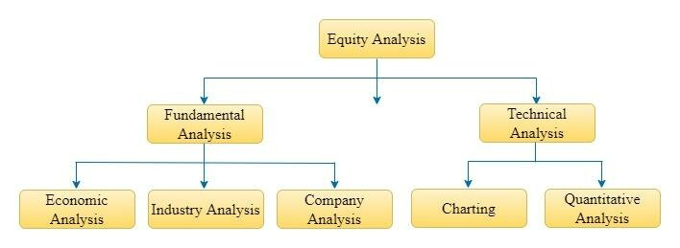
STOCK MARKET ANALYSIS APPROACH
System Requirements:
Traders Need To Gain A Perspective On What Makes A Company Unique For Investment. Thus, Stock Analysis Involves Several Aspects Such As Studying Current Financials, Future Business Plans, Growth Potential, Sectoral Sentiment And More. The Idea Is To Forecast The Future Using Historical Data.

Slide 8
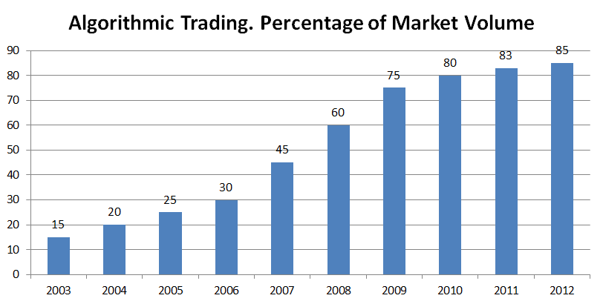
STOCK MARKET ALGORITHM & DEPLOYMENT
Algorithmic Trading Is A Method Of Executing Orders Using Automated Pre-programmed Trading Instructions Accounting For Variables Such As Time, Price, And Volume. This Type Of Trading Attempts To Leverage The Speed And Computational Resources Of Computers Relative To Human Traders. In The Twenty-first Century, Algorithmic Trading Has Been Gaining Traction With Both Retail And Institutional Tradersa Study In 2019 Showed That Around 92% Of Trading In The Forex Market Was Performed By Trading Algorithms Rather Than Humans.

Slide 9
CONCLUSION
The Share Market Is A Dynamic Ecosystem That Provides Opportunities For Individuals To Become A Part Of The Growth Story Of Companies And Potentially Realize Financial Gains

Slide 10
FUTURE SCOPE
The Future Of The Indian Stock Market Looks Promising, With The Sensex Index Poised To Scale New Heights In The Coming Years. Driven By A Strong Economy, Technological Advancements, And A Young, Apparitional Population, The Stock Market Is Expected To Offer Attractive Investment Opportunities For Discerning Investors.
REFERENCES
https://www.kaggle.com/datasets/afumetto/3dprinter

Slide 11
THANK YOU

